Slide 1
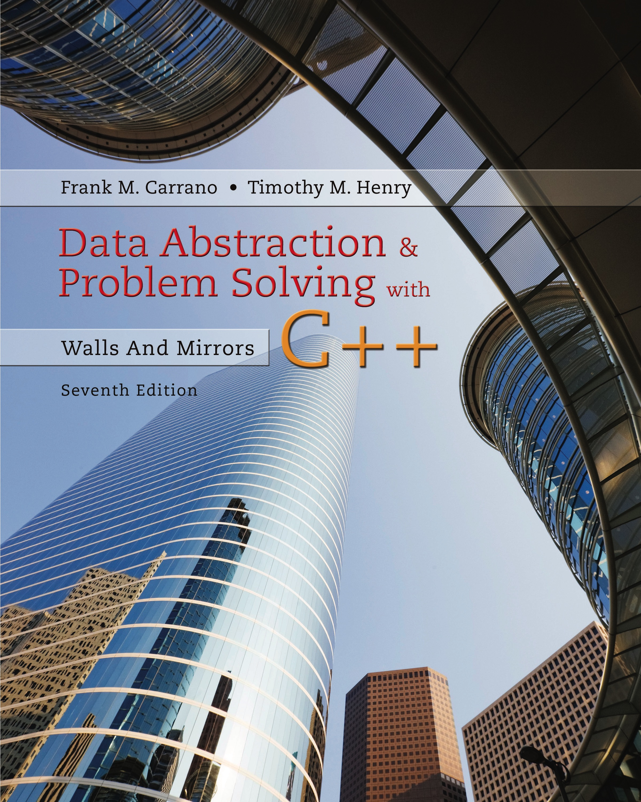
Data Abstraction & Problem Solving with C + +: Walls and Mirrors
Seventh Edition
Chapter 8
Lists
Copyright © 2017, 2013, 2007 Pearson Education, Inc. All Rights Reserved
Notes:
If this PowerPoint presentation contains mathematical equations, you may need to check that your computer has the following installed:
1) MathType Plugin
2) Math Player (free versions available)
3) NVDA Reader (free versions available)

Slide 2
Specifying the A D T List (1 of 4)
Things you make lists of
Chores
Addresses
Groceries
Lists contain items of the same type
Operations
Count items
Add, remove items
Retrieve

Slide 3
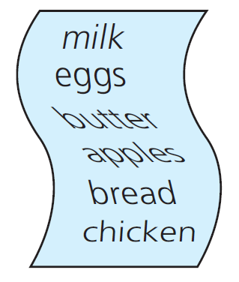
Specifying the A D T List (2 of 4)
Figure 8-1 A grocery list

Slide 4
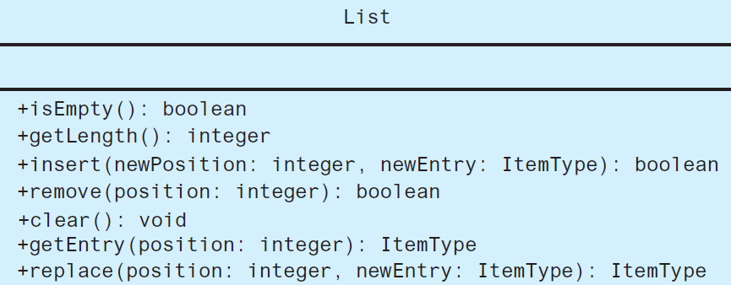
Specifying the A D T List (3 of 4)
Figure 8-2 U M L diagram for the A D T list

Slide 5
Specifying the A D T List (4 of 4)
Definition: A D T List
Finite number of objects
Not necessarily distinct
Same data type
Ordered by position as determined by client

Slide 6
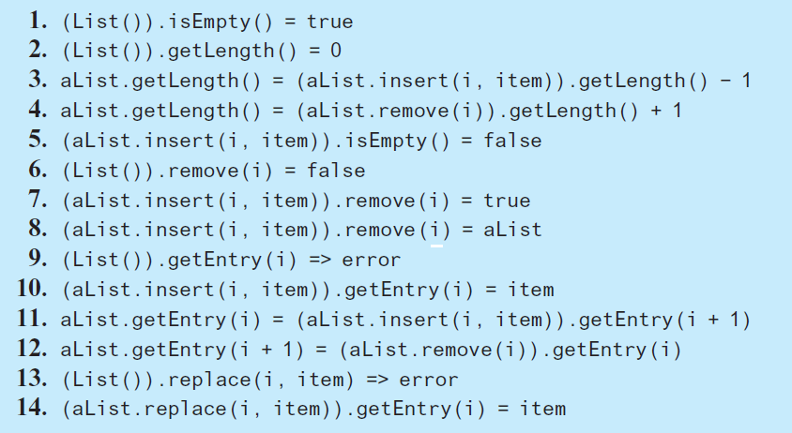
Axioms for A D T List

Slide 7
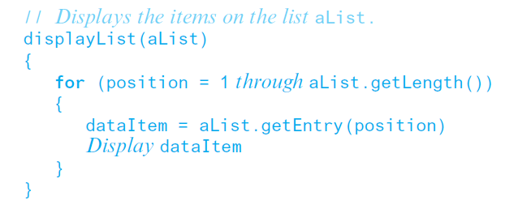
Using the List Operations (1 of 2)
Displaying the items on a list.

Slide 8
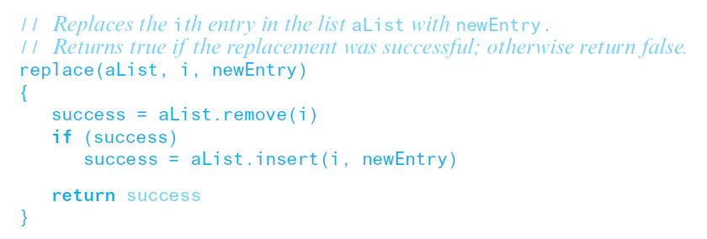
Using the List Operations (2 of 2)
Replacing an item.

Slide 9
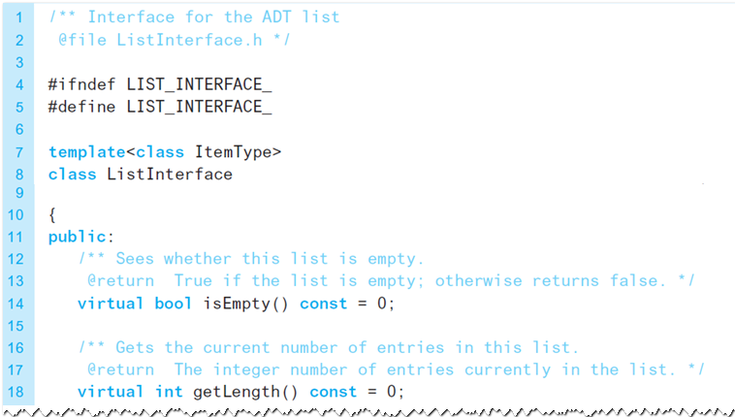
Interface Template for A D T List (1 of 4)
Listing 8-1 A C++ interface for lists

Slide 10
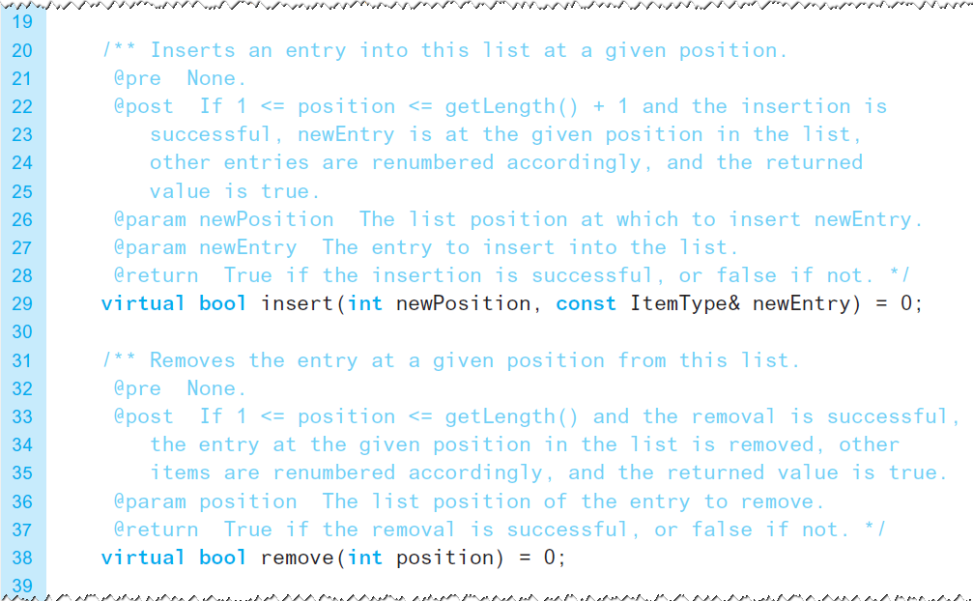
Interface Template for A D T List (2 of 4)
Listing 8-1 [Continued]

Slide 11
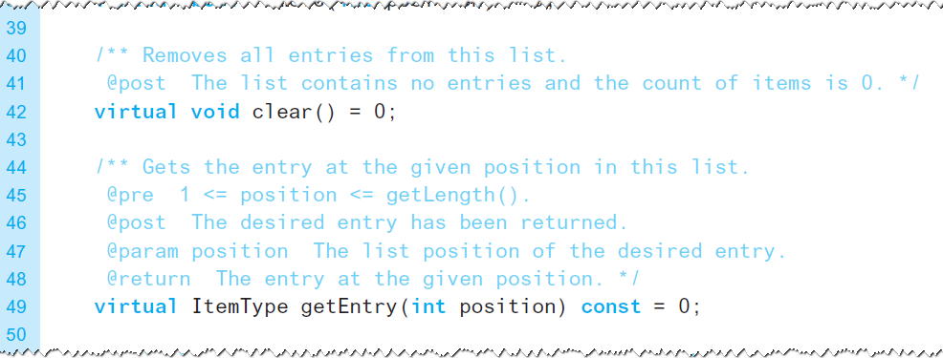
Interface Template for A D T List (3 of 4)
Listing 8-1 [Continued]

Slide 12
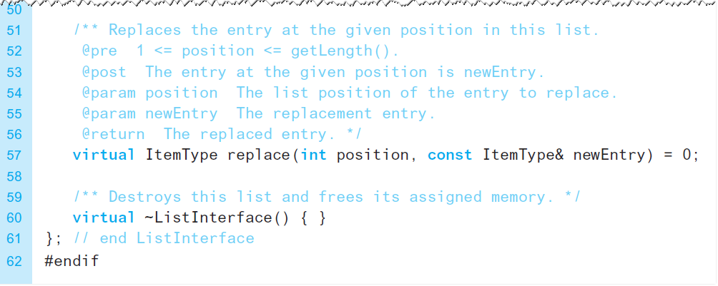
Interface Template for A D T List (4 of 4)
Listing 8-1 [Continued]

Slide 13

Copyright

